Slide 1
Data Warehousing - session -6
Mr. Atul Vaze
Certified BI Specialist(OBIEE)
Certified Agile Coach (ICP-ACC)
Function Point Specialist
Six Sigma GB

Slide 2
Books
Text Books:
T1: Ponniah P, “Data Warehousing Fundamentals”, Wiley Student Edition, 2012
T2: Kimball R, “The Data Warehouse Toolkit”, 3e, John Wiley, 2013
Reference Books :
R1 : Anahory S, & Dennis M, “Data Warehousing in the Real World”, Pearson Education, 2008.
R2 : Kimball R, Reeves L, Ross M, & Thornthwaite, W, “The Data Warehouse Lifecycle Toolkit”, John Wiley, 2e, 2012.
R3: Jiawei Han, Micheline Kamber and Jian Pei, “Data Mining: Concepts and Techniques”, Morgan Kaufmann Publishers 2012
R4: Krish Krishnan, “Data Warehousing in the Age of Big Data”, Morgan Kaufmann Publishers 2013
Note: In order to broaden understanding of concepts as applied to Indian IT industry, students are advised to refer books of their choice and case-studies in their own organizations

Slide 3
TOPICS
OLAP Introduction
OLAP Cubes
OLAP Operations
  Roll-up
  Drill-Down
  Slice
  Dice
  Pivot
Types of OLAP
Advantages/Dis advantages

Slide 4
What is OLAP?
OLAP is a category of software that allows users to analyze information from multiple database systems at the same time. It is a technology that enables analysts to extract and view business data from different points of view.
OLAP stands for Online Analytical Processing.
Analysts frequently need to group, aggregate and join data. These operations in relational databases are resource intensive. With OLAP data can be pre-calculated and pre-aggregated, making analysis faster.
OLAP databases are divided into one or more cubes. The cubes are designed in such a way that creating and viewing reports become easy.

Slide 5
The Complete Decision Support System
Information Sources
Data Warehouse
Server
(Tier 1)
OLAP Servers
(Tier 2)
Clients
(Tier 3)
e.g., MOLAP
Semistructured
Sources
Analysis
Data
Warehouse
serve
extract
transform
load
refresh
etc.
Query/Reporting
serve
e.g., ROLAP
Operational
DB’s
serve
Data Mining
Data Marts

Slide 6
OLAP for Decision Support
OLAP = Online Analytical Processing
Support (almost) ad-hoc querying for business analyst
Think in terms of spreadsheets
  View sales data by geography, time, or product
Extend spreadsheet analysis model to work with warehouse data
  Large data sets
  Semantically enriched to understand business terms
  Combine interactive queries with reporting functions
Multidimensional view of data is the foundation of OLAP
  Data model, operations, etc.

Slide 7
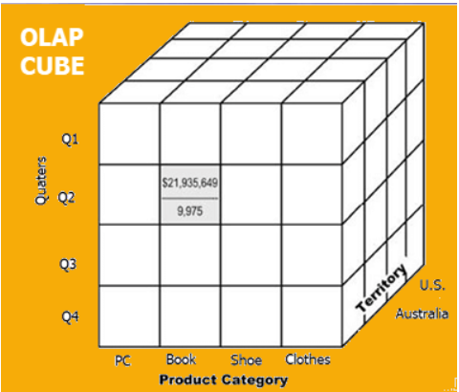
OLAP Cube
At the core of the OLAP, concept is an OLAP Cube. The OLAP cube is a data structure optimized for very quick data analysis.
The OLAP Cube consists of numeric facts called measures which are categorized by dimensions.
Usually, data operations and analysis are performed using the simple spreadsheet, where data values are arranged in row and column format. This is ideal for two-dimensional data. However, OLAP contains multidimensional data, with data usually obtained from a different and unrelated source. Using a spreadsheet is not an optimal option. The cube can store and analyze multidimensional data in a logical and orderly manner.
A Data warehouse would extract information from multiple data sources and formats like text files, excel sheet, multimedia files, etc.
The extracted data is cleaned and transformed. Data is loaded into an OLAP server (or OLAP cube) where information is pre-calculated in advance for further analysis.

Slide 8
Typical Calculations
Roll-ups to provide summaries and aggregations along the hierarchies of the dimensions.
Drill-downs from the top level to the lowest along the hierarchies of the dimensions in combinations among the dimensions.
Simple calculations, such as computation of margins (sales minus costs).
Share calculations to compute the percentage of parts to the whole.
Algebraic equations involving key performance indicators.
Moving averages and growth percentages.
Trend analysis using statistical methods.

Slide 9
OLAP operations
LINE | 1998 | 1999 | 2000 | TOTAL
Clothing | $3,457,000 | $3,590,050 | $5,789,400 | $12,836,450
Electronics | $5,894,800 | $4,078,900 | $6,094,600 | $16,068,300
Video | $7,198,700 | $6,057,890 | $8,005,600 | $21,262,190
Kitchen | $4,875,400 | $5,894,500 | $6,934,500 | $17,704,400
Appliances | $5,947,300 | $6,104,500 | $7,549,000 | $19,600,800
Total | $27,373,200 | $25,725,840 | $34,373,100 | $87,472,140
Drill down
LINE | TOTAL SALES
Clothing | $12,836,450
Electronics | $16,068,300
Video | $21,262,190
Kitchen | $17,704,400
Appliances | $19,600,800
Total | $87,472,140
Rotate / Pivot
YEAR | Clothing | Electronics | Video | Kitchen | Appliances | TOTAL
1998 | $3,457,000 | $5,894,800 | $7,198,700 | $4,875,400 | $5,947,300 | $27,373,200
1999 | $3,590,050 | $4,078,900 | $6,057,890 | $5,894,500 | $6,104,500 | $25,725,840
2000 | $5,789,400 | $6,094,600 | $8,005,600 | $6,934,500 | $7,549,000 | $34,373,100
Total | $12,836,450 | $16,068,300 | $21,262,190 | $17,704,400 | $19,600,800 | $87,472,140

Slide 10
Limitations of Other Tools
Users need ability to analyse the data along multiple dimensions and their hierarchies rapidly
Spreadsheets can be cumbersome to use, particularly for large volumes of data.
Multidimensional data entered in spreadsheet has lot of redundancy
It will require enormous effort to do create multidimensional view

Slide 11
Limitations of Other Tools
SQL was originally meant to be end-user query language
Except for very simple operations, the syntax is not easy to conceptualize for end-users
The vocabulary is not suitable for analysis, comparisons are a challenge
SQL is not good with complex calculations and time-series data.

Slide 12
Limitations of Other Tools
A real-world analysis session requires many queries following one after the other.
Each query may translate into a number of statements invoking full table scans, multiple joins, aggregations, groupings, and sorting.
The overhead on the systems would be enormous and seriously impact the response times

Slide 13
Features of OLAP
Multidimensional analysis | Consistent performance | Fast response times for interactive queries
Drill-down and roll-up | Navigation in and out of details | Slice-and-dice or rotation
Multiple view modes | Easy scalability | Time intelligence (yearto-date, fiscal period)
Basic Features
Advanced Features
Powerful calculations | Cross-dimensional calculations | Pre-calculation or pre-consolidation
Drill-through across dimensions or details | Sophisticated presentation & displays | Collaborative decision making
Derived data values through formulas | Application of alert technology | Report generation with agent technology

Slide 14
Basic analytical operations of OLAP
Four types of analytical operations in OLAP are:
Roll-up
Drill-down
Slice and dice
Pivot (rotate)

Slide 15
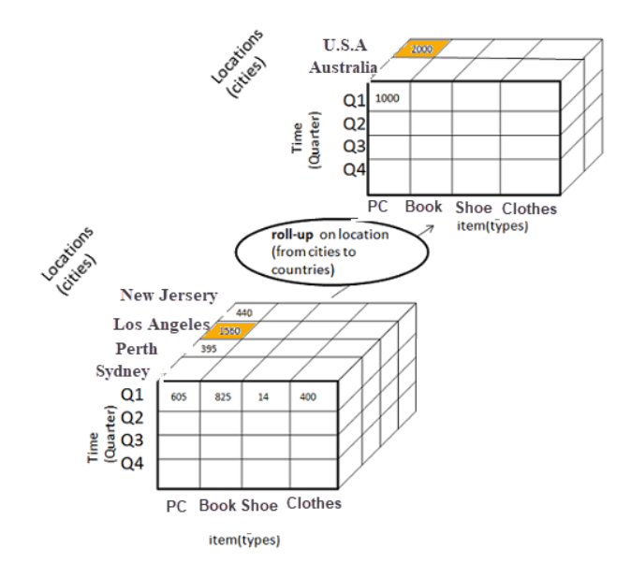
Roll-up:
Roll-up is also known as "consolidation" or "aggregation." The Roll-up operation can be performed in 2 ways
Reducing dimensions
Climbing up concept hierarchy. Concept hierarchy is a system of grouping things based on their order or level.
Consider the following diagram
In this example, cities New jersey and Los Angles and rolled up into country USA
The sales figure of New Jersey and Los Angeles are 440 and 1560 respectively. They become 2000 after roll-up
In this aggregation process, data is location hierarchy moves up from city to the country.
In the roll-up process at least one or more dimensions need to be removed..

Slide 16
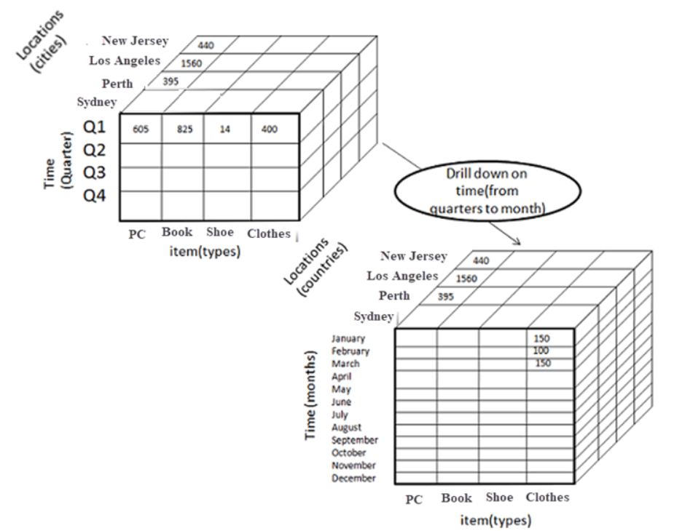
Drill-down
In drill-down data is fragmented into smaller parts. It is the opposite of the rollup process. It can be done via
Moving down the concept hierarchy
Increasing a dimension
Consider the diagram:
Quarter Q1 is drilled down to
months January, February, and March.
Corresponding sales are also registers.
In this example, dimension months are
added.

Slide 17
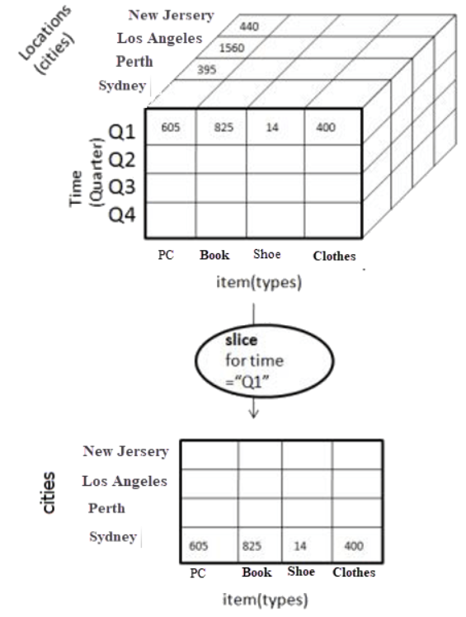
Slice:
Here, one dimension is selected, and a new sub-cube is created.
Following diagram explain how slice operation performed:
Dimension Time is Sliced with Q1 as the filter.
A new cube is created altogether.

Slide 18
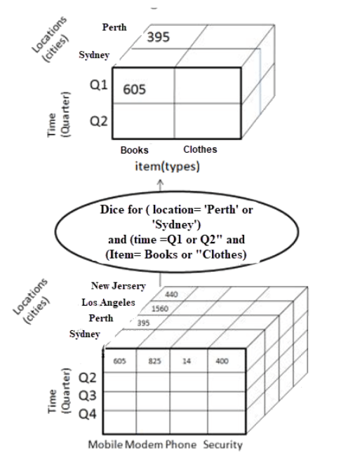
Dice
This operation is similar to a slice. The difference in dice is you select 2 or more dimensions that result in the creation of a sub-cube.

Slide 19
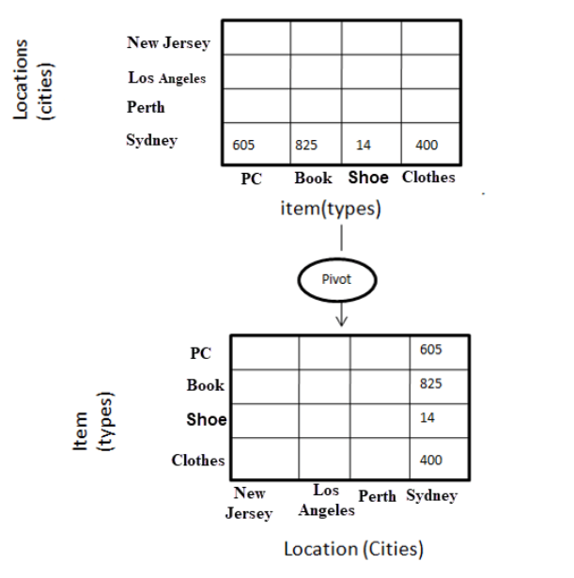
Pivot
In Pivot, you rotate the data axes to provide a substitute presentation of data.
In the following example, the pivot is based on item types.

Slide 20
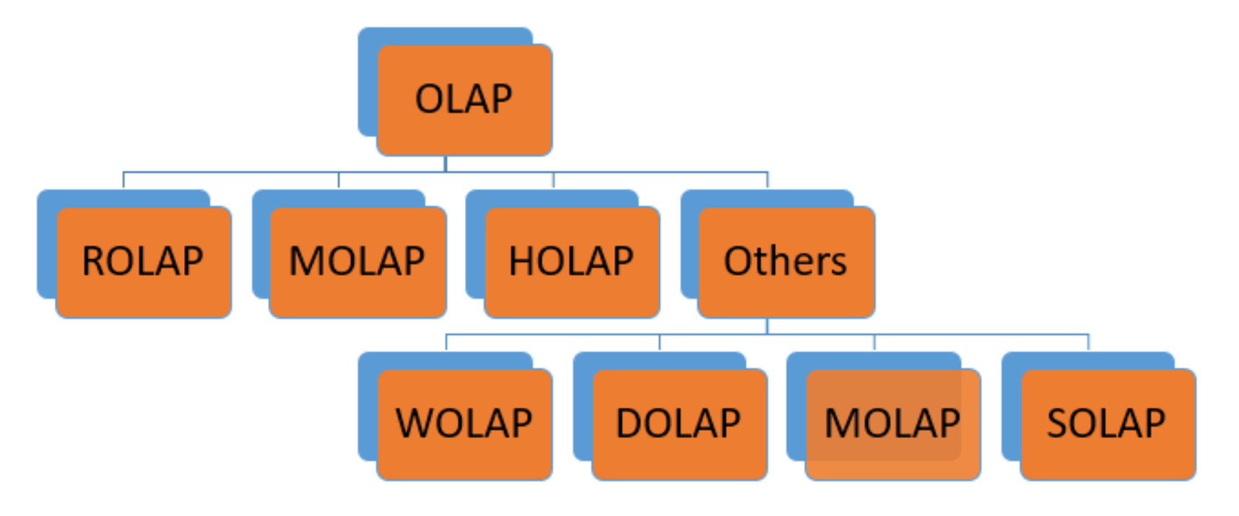
Types of OLAP

Slide 21
Type of OLAP | Explanation
Relational OLAP(ROLAP): | ROLAP is an extended RDBMS along with multidimensional data mapping to perform the standard relational operation.
Multidimensional OLAP (MOLAP) | MOLAP Implementes operation in multidimensional data.
Hybrid OnlineAnalytical Processing (HOLAP) | In HOLAP approach the aggregated totals are stored in a multidimensional database while the detailed data is stored in the relational database. This offers both data efficiency of the ROLAP model and the performance of the MOLAP model.
Desktop OLAP (DOLAP) | In Desktop OLAP, a user downloads a part of the data from the database locally, or on their desktop and analyze it. DOLAP is relatively cheaper to deploy as it offers very few functionalities compares to other OLAP systems.
Web OLAP (WOLAP) | Web OLAP which is OLAP system accessible via the web browser. WOLAP is a three-tiered architecture. It consists of three components: client, middleware, and a database server.
Mobile OLAP: | Mobile OLAP helps users to access and analyze OLAP data using their mobile devices
Spatial OLAP : | SOLAP is created to facilitate management of both spatial and non-spatial data in a Geographic Information system (GIS)

Slide 22
ROLAP
ROLAP works with data that exist in a relational database. Facts and dimension tables are stored as relational tables. It also allows multidimensional analysis of data and is the fastest growing OLAP.
Advantages of ROLAP model:
High data efficiency. It offers high data efficiency because query performance and access language are optimized particularly for the multidimensional data analysis.
Scalability. This type of OLAP system offers scalability for managing large volumes of data, and even when the data is steadily increasing.
Drawbacks of ROLAP model:
Demand for higher resources: ROLAP needs high utilization of manpower, software, and hardware resources.
Aggregately data limitations. ROLAP tools use SQL for all calculation of aggregate data. However, there are no set limits for handling computations.
Slow query performance. Query performance in this model is slow when compared with MOLAP

Slide 23
MOLAP
Multidimensional OLAP (MOLAP) is a classical OLAP that facilitates data analysis by using a multidimensional data cube.
Data is pre- computed, pre-summarized, and stored in a MOLAP (a major difference from ROLAP).
Using a MOLAP, a user can use multidimensional view data with different facets. Multidimensional data analysis is also possible if a relational database is used. By that would require querying data from multiple tables. On the contrary, MOLAP has all possible combinations of data already stored in a multidimensional array. MOLAP can access this data directly. Hence, MOLAP is faster compared to Relational Online Analytical Processing (ROLAP).
Notes:
https://www.guru99.com/multidimensional-online-analytical-processing.html

Slide 24
Hybrid OLAP
Hybrid OLAP is a mixture of both ROLAP and MOLAP. It offers fast computation of MOLAP and higher scalability of ROLAP. HOLAP uses two databases.
Aggregated or computed data is stored in a multidimensional OLAP cube
Detailed information is stored in a relational database.
Benefits of Hybrid OLAP:
This kind of OLAP helps to economize the disk space, and it also remains compact which helps to avoid issues related to access speed and convenience.
Hybrid HOLAP's uses cube technology which allows faster performance for all types of data.
ROLAP are instantly updated and HOLAP users have access to this real-time instantly updated data. MOLAP brings cleaning and conversion of data thereby improving data relevance. This brings best of both worlds.
Drawbacks of Hybrid OLAP:
Greater complexity level: The major drawback in HOLAP systems is that it supports both ROLAP and MOLAP tools and applications. Thus, it is very complicated.
Potential overlaps: There are higher chances of overlapping especially into their functionalities.

Slide 25
Advantages /Disadvantages of OLAP
Advantages:
OLAP is a platform for all type of business includes planning, budgeting, reporting, and analysis.
Information and calculations are consistent in an OLAP cube. This is a crucial benefit.
Quickly create and analyze "What if" scenarios
Easily search OLAP database for broad or specific terms.
OLAP provides the building blocks for business modeling tools, Data mining tools, performance reporting tools.
Allows users to do slice and dice cube data all by various dimensions, measures, and filters.
It is good for analyzing time series.
Finding some clusters and outliers is easy with OLAP.
It is a powerful visualization online analytical process system which provides faster response times

Slide 26
Advantages /Disadvantages of OLAP
Disadvantages:
OLAP requires organizing data into a star or snowflake schema. These schemas are complicated to implement and administer
You cannot have large number of dimensions in a single OLAP cube
Transactional data cannot be accessed with OLAP system.
Any modification in an OLAP cube needs a full update of the cube. This is a time-consuming process

Slide 27

An Analysis Session
Sharp enterprise-wide profitability dip
Countrywide monthly sales for last 3 months?
Sales OK, profitability down last 3 months
Monthly sales by worldwide regions?
Sharp reduction in European region
European sales by countries ?
Increase in a few countries, flat in others, sharp decline in some
European sales by countries, products?
Additional tax on some products in EU
Direct and indirect costs for EU countries?
Sharp decline in EU countries, last 2 months
Direct costs OK, indirect costs up

Slide 28
Summary of Operations
Aggregation (roll-up)
  aggregate (summarize) data to the next higher dimension element
  e.g., total sales by city, year → total sales by region, year
Navigation to detailed data (drill-down)
Selection (slice) defines a subcube
  e.g., sales where city =‘Gainesville’ and date = ‘1/15/90’
Calculation and ranking
  e.g., top 3% of cities by average income
Visualization operations (e.g., Pivot)
Time functions
  e.g., time average

Slide 29
Cube Complexity :
Data Cube: A Lattice of Cuboids
all
0-D(apex) cuboid
time
item
location
supplier
1-D cuboids
time,location
item,location
location,supplier
2-D cuboids
time,item
time,supplier
item,supplier
time,location,supplier
3-D cuboids
time,item,location
time,item,supplier
item,location,supplier
4-D(base) cuboid
time, item, location, supplierc

Slide 30
Multidimensional Data
Sales volume as a function of product, month, and region
Dimensions: Product, Location, Time
Hierarchical summarization paths
Region
Industry Region Year
Category Country Quarter
Product City Month Week
Office Day
Product
Month

Slide 31
General Strategies for Data Cube Computation
Sorting, hashing, and grouping. Sorting, hashing, and grouping operations should be applied to the dimension attributes to reorder and cluster related tuples.
  In cube computation, aggregation is performed on the tuples (or cells) that share the same set of dimension values. Thus, it is important to explore sorting, hashing, and grouping operations to access and group such data together to facilitate computation of such aggregates.
  To compute total sales by branch, day, and item, for example, it can be more efficient to sort tuples or cells by branch, and then by day, and then group them according to the item name.

Slide 32
General Strategies for Data Cube Computation
Simultaneous aggregation and caching of intermediate results. In cube computation, it is efficient to compute higher-level aggregates from previously computed lower-level aggregates, rather than from the base fact table. Moreover, simultaneous aggregation from cached intermediate computation results may lead to the reduction of expensive disk input/output (I/O) operations.
  To compute sales by branch, for example, we can use the intermediate results derived from the computation of a lower-level cuboid such as sales by branch and day. This technique can be further extended to perform amortized scans (i.e., computing as many cuboids as possible at the same time to amortize disk reads).

Slide 33
Thank You
Any Questions?

